Slide 1
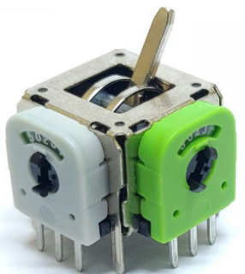
Ax
REMOTE CHANNEL ALLOCATIONS
D2
Arduino Digital Pins
Reserved SCL/SDA
Dx
NodeMCU PWM Pins
D5
CHANNEL_5 – Nav Lights
D1
A0
NodeMCU Analog Pin (reserved)
D6
CHANNEL_6 – Beacon buzzer
SDA
SCL
D4
A2
D7
A4
A5
A0
D0
A3
OLED DISPLAY
A1
D3
CHANNEL_3 [pitch/yaw]
CHANNEL_1 [throttle up/down]
CHANNEL_4 [roll left/right]
CHANNEL_2 [left/right]

Slide 2
DRONE CHANNEL ALLOCATIONS
Dx
NodeMCU PWM Pins
A0
NodeMCU Analog Pin
TX/RX
D7
D6
D5
D4
NodeMCU UART Pin
ESC CONTROLLER 1,2,3,4
SCL
SDA
D1
D2
D0
TOF LIDAR + MPU6050
NAVIGATION LIGHTS/CAMERA/BUZZER
TX(22)
RX(21)
A0
BATTERY LEVEL DETECTION
GPS Receiver

